Slide 1

Comparative Data Analysis
Global Climate Change, Taxi Transport Data & Flight prices
Analysis | Normalization | Big Data Performance

Slide 2



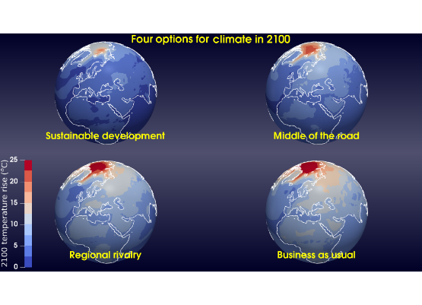
Project Scope & Datasets
Dataset 1: Climate
Dataset 2: Medium (NYC Taxi)
Dataset 3: Flight prices
Size: Small (~1 MB)
Size: Medium (~5 GB)
Size: Massive (>30 GB)
Tools: Pandas, NumPy, Matplotlib
Tools: Pandas, PySpark
Tools: Pandas, PySpark
Goal: Wrangling, 3NF, Visualization
Goal: Initial Speed Comparison
Goal: Real-World Scalability Test

Slide 3
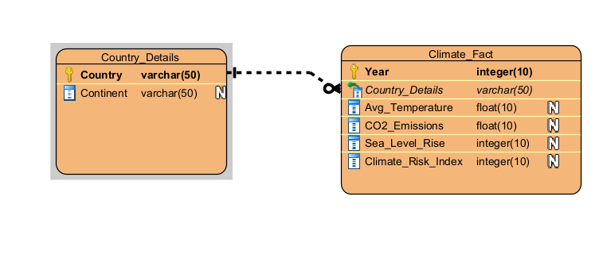
Data Modeling: 3NF
To ensure data integrity and reduce redundancy, the Climate dataset was normalized to the Third Normal Form (3NF).
Process:
•
Eliminated partial dependencies.
•
Removed transitive dependencies (e.g., separating Country and Continent details from the main Emissions fact table).
Modeled using Visual Paradigm.

Slide 4
Data Dictionary: Climate Dataset
Variable Names | Data Type | Description
Year | Integer | The calendar year of observation (2020-2025).
Continent | Varchar | Geographical region (e.g., Asia, Europe).
Avg_Temperature_C | Float | Average annual temperature in Celsius.
CO2_Emissions_Mt | Float | Total Carbon Dioxide emissions in Million Tonnes.
Climate_Risk_Index | Integer | Composite score (0-100) indicating vulnerability.
Sea Level Rise | Integer | Tracks the rate at which the Sea Level rises

Slide 5






Python & Pandas Proficiency
Data Wrangling
OOP & NumPy
Analysis
Implemented custom functions to detect and impute missing values (mean strategy) and categorized risk indices using conditional logic.
Utilized NumPy arrays for high-performance statistical calculations (Mean, Std Dev) and Object-Oriented principles for code structure.
Leveraged Pandas groupby() and sort_values() to aggregate metrics by continent and identify high-risk regions.

Slide 6


Python & Pandas Proficiency

Slide 7
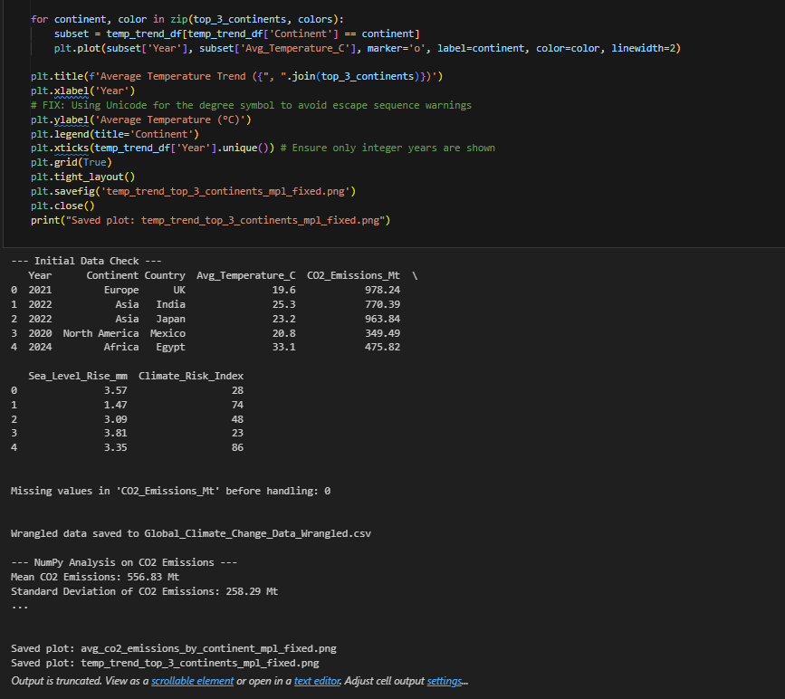
Python & Pandas Proficiency

Slide 8
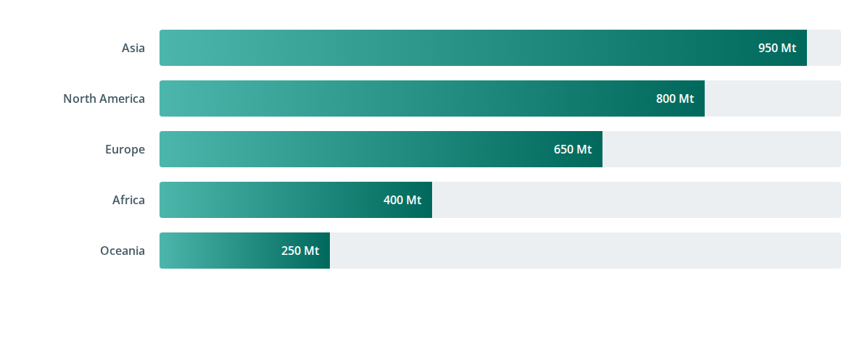
Avg. CO2 Emissions by Continent (2020-2025)
Asia leads in total emissions, driven by industrial output, while Oceania maintains the lowest footprint.

Slide 9
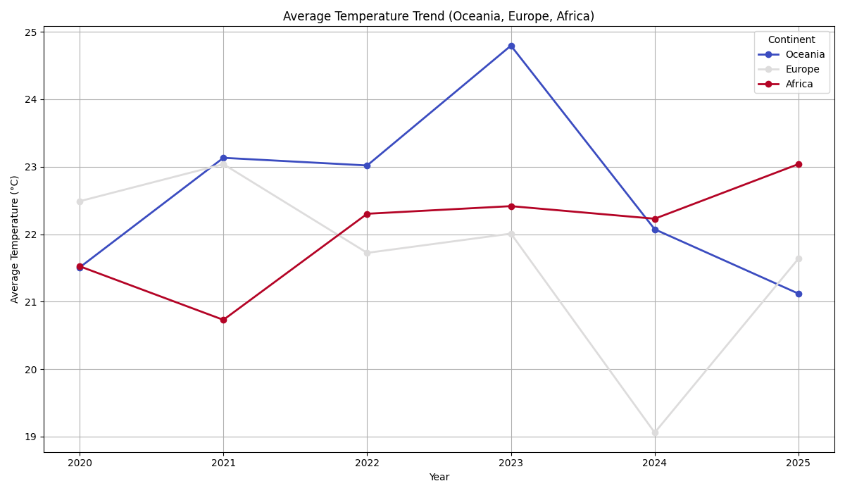
Global Temperature Trends (Top 3 High-Risk Regions)
High-risk regions show a steeper temperature gradient over the 5-year period.

Slide 10


Strategic Insights (Climate)
Policy Strategy
Risk Management
Q: Is there a correlation between CO2 output and temperature rise?
Q: Which regions require immediate infrastructure investment?
A: Yes, data indicates a strong positive correlation. Mitigation policies must focus on the top 3 emitting continents to curb global temperature acceleration.
A: Regions with a Risk Index > 80 (e.g., parts of Africa and Asia) show the highest vulnerability to sea-level rise and should be prioritized.

Slide 11


1. Risk Prioritization & Allocation
Q1: Highest Risk
Q2: CO2 Efficiency
Oceania (56.7), Europe (56.3), and Africa (56.1) face the highest average Climate Risk Indices. Globally, 45.8% of all observations fall into the 'High' risk category (Index ≥60), indicating widespread vulnerability.
Asia has the highest ratio of CO2 Emissions to Climate Risk (10.43). This identifies it as a region where emission reductions could yield the most significant relative impact on the risk profile.

Slide 12






2. Emissions & Benchmarking
Q3: Global Baseline
Q4: Peak Year
Q5: Top Emitters
Mean CO2 is 556.83 Mt. A high standard deviation (258.29 Mt) confirms substantial variability, with outliers reaching near 1000 Mt.
2022 recorded the highest average CO2 emissions (585.33 Mt), serving as a key target year for investigating industrial activity spikes.
Asia (583.9 Mt) and North America (583.6 Mt) are the primary contributors, identifying them as priority targets for mitigation.

Slide 13






3. Vulnerability & Impacts
Q6: Sea Level Rise
Q7: Heat Stress
Q8: Warming Trend
Africa faces the most severe impact with 3.08 mm average rise, necessitating urgent coastal adaptation infrastructure investment.
South America records the highest average temperature (22.82°C), highlighting a need for heat-related public health strategies.
High-risk continents (Oceania, Europe, Africa) show a consistent increasing trend in temperature, compounding their existing vulnerability.

Slide 14

The Big Data Challenge
While Pandas excels at small-scale analysis, it faces critical limitations with large datasets (>5GB) typical in enterprise environments.
The Solution: Apache Spark
•
Distributed Computing (Cluster-based).
•
Lazy Evaluation (Optimized execution plans).
•
Fault Tolerance.

Slide 15



Performance Comparison Methodology
Benchmarking Pandas vs. Spark across Three Data Scales
Load Data
Process
Measure
Measure time to read CSV into memory/dataframe.
Perform a ‘Group by’ using some tables in each individual dataset
Record Wall Time (sec) and Memory Usage (MB).

Slide 16
Benchmark Results: Time and Memory
Operation | Tool | Small Data (~0.1 MB) | Medium Data (~5 GB) | Massive Data (>30 GB)
Total Execution | Pandas | 0.35 s | 25.19 s | MemoryError (Crash)
 | Spark | ~0.50 s | 36.75 s | 803.88 s
Aggregation Time | Pandas | 0.001 s | 0.29 s | N/A
 | Spark | ~0.30 s | 9.18 s | 394.96 s
Memory Profile | Pandas | In-RAM (0.1 MB) | In-RAM (Risk) | Out of RAM
 | Spark | Optimized/Spillable | Optimized/Spillable | Optimized/Spillable

Slide 17
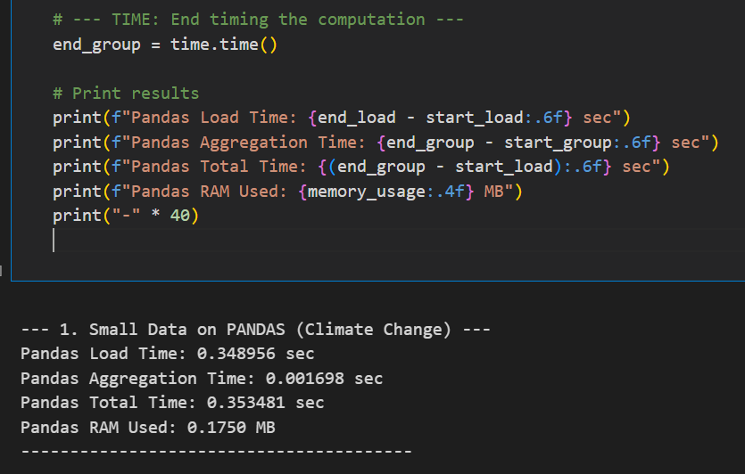
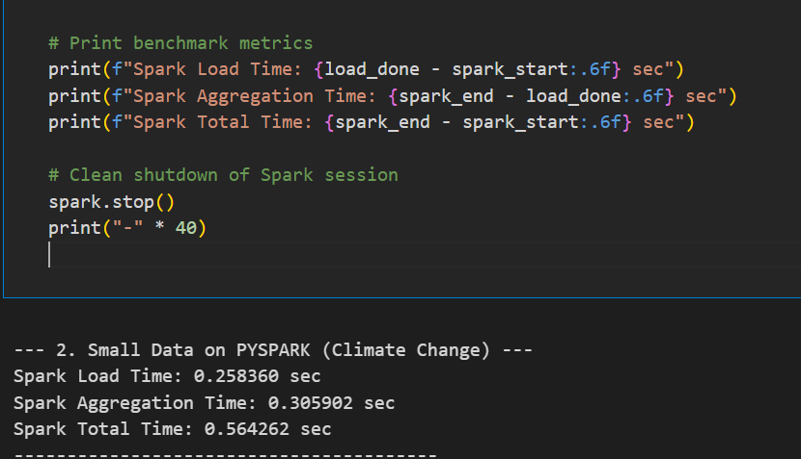
Screenshot of code output: < 1mb Climate change dataset
Pandas
Pyspark

Slide 18
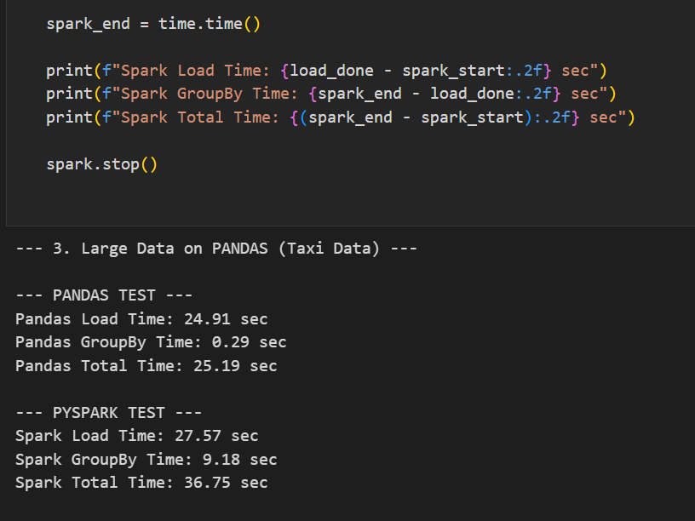
Screenshot of code output: Around 5gb Taxi dataset
Pandas
Pyspark

Slide 19
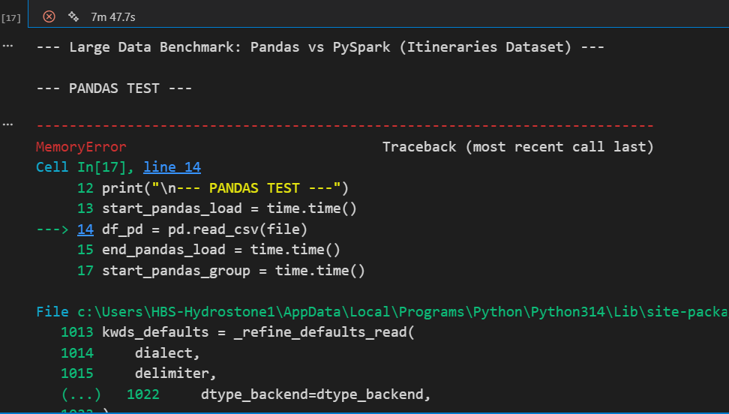
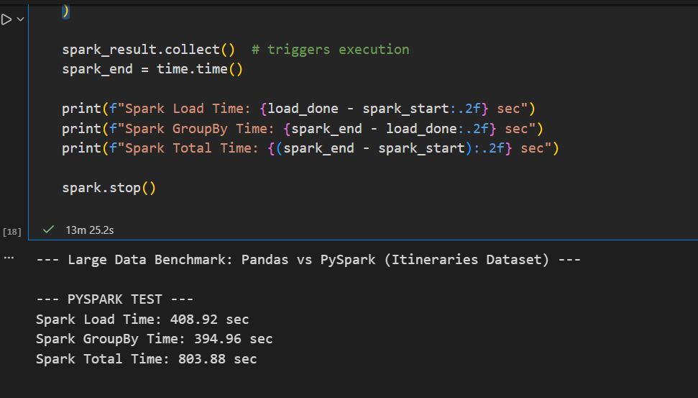
Screenshot of code output: > 30GB flight dataset
Pandas
Pyspark

Slide 20
Three-Phase Analysis: Speed vs. Scalability
Phase 1: Small Data (0.1 MB): Pandas is Faster. Its low-level, in-memory operations beat Spark by a significant margin (0.35s vs. ~0.50s), making it ideal for local EDA.
Phase 2: Medium Data (<5 GB): Pandas is Still Faster in Total Time (25.19s vs. 36.75s). However, Spark's aggregation time (9.18s) is more robust due to parallel processing, and Pandas is approaching its memory limit.
Phase 3: Massive Data (>30 GB): Spark is the Only Solution! Pandas failed with a `MemoryError` (crash), whereas PySpark successfully completed the 803-second job by utilizing distributed resources and intelligently spilling data to disk.
Conclusion: Scalability trumps speed for production data. For anything over 5GB, Spark provides necessary capacity and reliability.

Slide 21


Strategic Insights (Big Data)
Infrastructure Cost
Real-time Processing
Q: Should we migrate all pipelines to Spark?
Q: Can we use this for real-time dashboards?
A: Only for data exceeding 5GB. For smaller analytical tasks, Pandas is more cost-effective and developer-friendly (lower complexity).
A: Spark Streaming is recommended for real-time ingestion. Pandas is suitable only for static, batch reporting on smaller subsets.

Slide 22

Final Recommendation
Hybrid Approach:
•
Use Pandas for data exploration, cleaning, and reporting on datasets < 5GB.
•
Deploy Apache Spark for production pipelines involving high-volume historical data or ETL processes exceeding memory limits.

